Slide 1
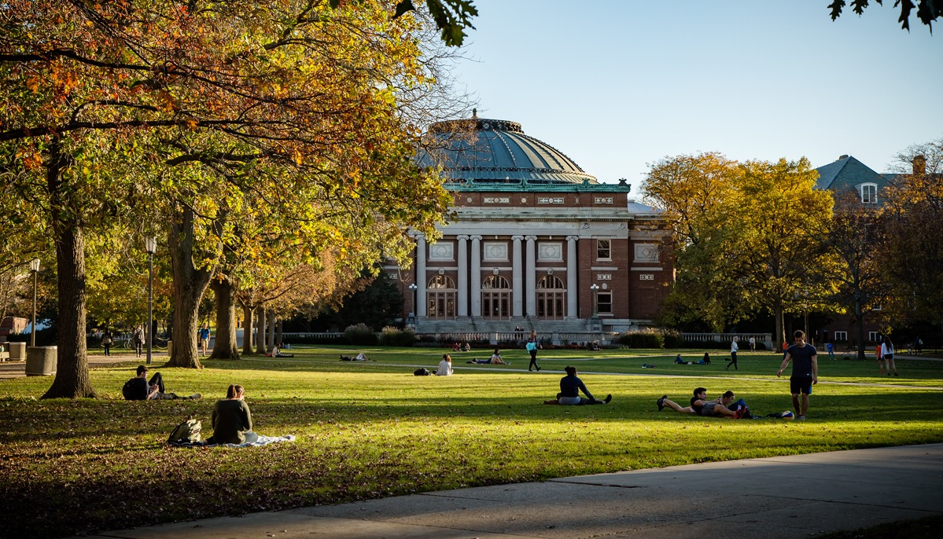
ILLINOIS RESEARCH
OVERVIEW
SUMMER 2021
UNIVERSITY OF ILLINOIS URBANA-CHAMPAIGN

Slide 2
THE UNIVERSITY OF ILLINOIS URBANA-CHAMPAIGN
33492 UNDERGRADUATES
18,839 GRADUATES
3,053 FACULTY
1,962 TENURE TRACK
1,091 SPECIALIZED FALL 2020
FROM ALL 50 STATES & 115+ COUNTRIES
FALL 2020
3M+ SQUARE FOOTAGE FOR RESEARCH
874 EARNED DOCTORATES
150+ CENTERS, LABS,
AND INSTITUTES

Slide 3
THE ILLINOIS RESEARCH ENTERPRISE
Unique breadth, INTERDISCIPLINARY FOCUS
World-renowned programs in the natural
and physical sciences and engineering
Highly regarded strengths in the arts, agriculture, business, the humanities, and the social sciences

Slide 4
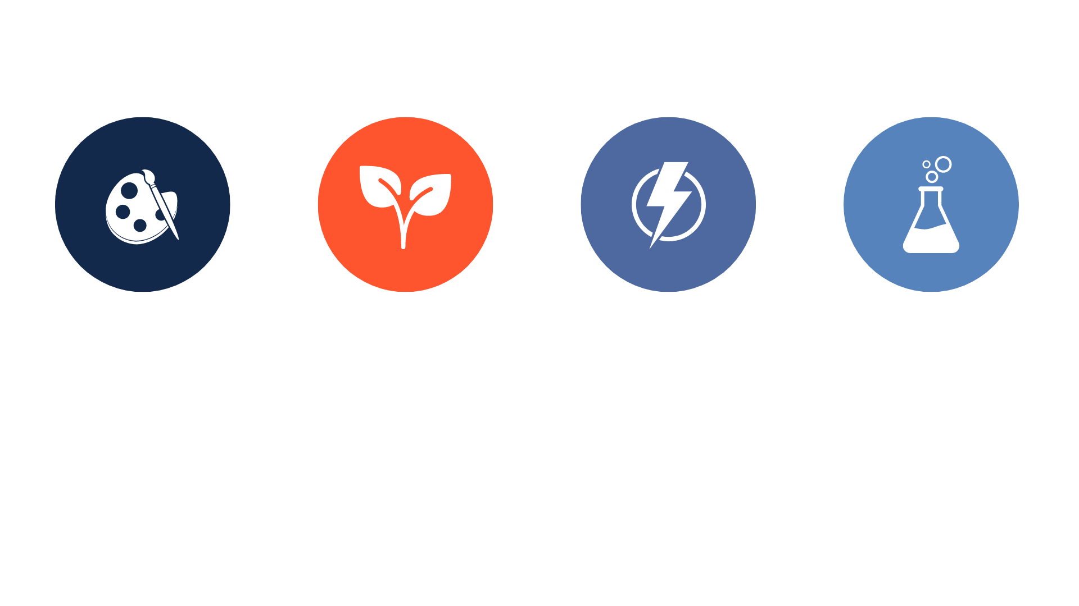
UNIQUE BREADTH, INTERDISCIPLINARY FOCUS
Exceptional success rates for NEH and Guggenheim fellowships
Regularly among the top 25 in USDA and DOD awards
Regularly among the top ten in DOE awards
Routinely leading the nation in NSF funding

Slide 5
TOTAL RESEARCH AND DEVELOPMENT EXPENDITURES
RESEARCH EXPENDITURES (IN MILLIONS)

Slide 6
FEDERAL RESEARCH EXPENDITURES BY AGENCY
FY20: $388M
*Includes NIH.

Slide 7
NOTABLE RECENT RESEARCH AWARDS
Coal FIRST Initiative
DOE
Illinois Metabolic Outcomes in Moms Study
DOD
$25M
$2.1M
Biology Integration Institute
NSF
AI Institutes
NSF
$12.5M
2 of 7
Biomaterials to Repair Skulls and Promote Regeneration
NIH
In vivo DNA Editing
NIH
$2.4M
$2.2M
Nutrition in Childcare Facilities
Robert Wood Johnson Foundation
Quantum Leap Challenge Institute
NSF
$250K
$25M

Slide 8
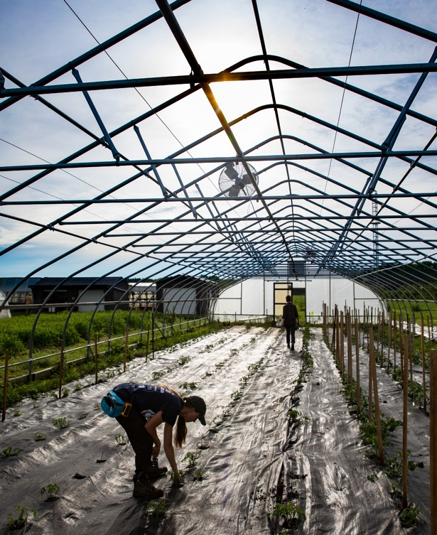
NOTABLE RESEARCH PROGRAMS
CENTER FOR ADVANCED BIOENERGY AND BIOPRODUCTS INNOVATION
Reducing the U.S.’s dependence on fossil fuels by developing efficient ways to grow bioenergy crops.
AI NSF INSTITUTES
UIUC selected to lead two of seven new national AI institutes: AI FARMS and the Molecule Maker Lab.
MICROBIAL SYSTEMS INITIATIVE
A vibrant microbial sciences research and training enterprise to address critical problems in health, agriculture, energy, and many other sectors.
HUMANITIES WITHOUT WALLS
Linking humanities research efforts at 16 universities throughout the Midwest and beyond.

Slide 9
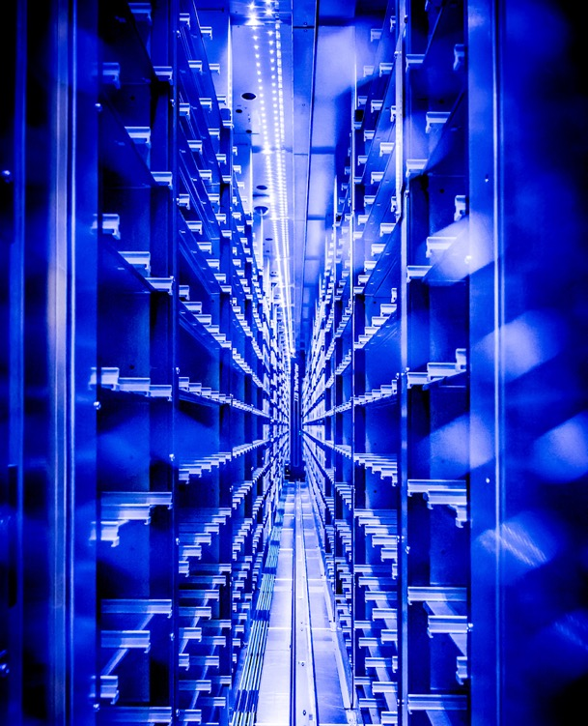
NOTABLE PARTNERSHIPS
C3.AI DIGITAL TRANSFORMATION INSTITUTE
$50M C3.ai Digital Transformation Institute launched in partnership with C3.ai, Microsoft, and leading U.S. universities.
NATIONAL SECURITY AGENCY FEATURED SCHOOL
Partnership to research the science behind secure networks and cyber systems.
MAYO CLINIC & ILLINOIS ALLIANCE
Alliance for joint research and educational programs that empower technology-based and computational-based healthcare.
URBANA-CHAMPAIGN COMMUNITY
The Community + Research Partnership Program unites Illinois researchers and community members to address local needs and interests through sustainable, equitable partnerships.

Slide 10
NOTABLE INFRASTRUCTURE
The University of Illinois Urbana-Champaign combines creativity, expertise,
and imagination with cutting-edge facilities to conduct world-changing research.
Family Resiliency Center
Beckman Biomedical Imaging Facility
IGB Core
Facilities
Rare Book and
Manuscript Library
Holonyak Micro + Nanotechnology Lab
Krannert Art Museum
Energy Farm
Roy J. Carver
Biotechnology Center

Slide 11
TECHNOLOGY COMMERCIALIZATION
340+ Active Licenses and Options
Received 215 new
invention reports
Executed 60 licenses
and options*
Note: Beginning with fiscal 2017, counts for U.S. patent applications and issued U.S. patents will include activity that was unaccounted for in the prior fiscal year (2016).
U.S. PATENT APPLICATIONS
ISSUED U.S. PATENTS
*Including 10 first licenses to
start-ups using University IP.
MORE THAN 800 ACTIVE, ISSUED U.S. PATENTS

Slide 12
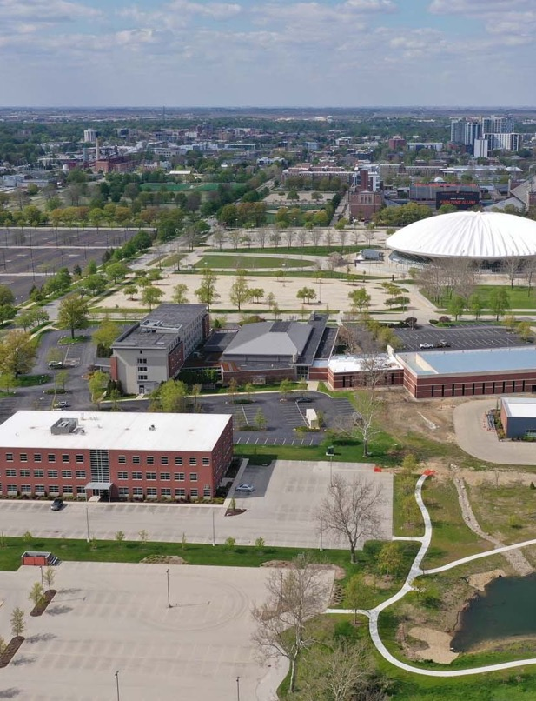
RESEARCH PARK: REMARKABLE GROWTH IN TWO DECADES
200+ ACRES, 17 BUILDINGS
795,000 square feet, including 43,000 square feet in incubator space.
125 COMPANIES
Including Abbott, Ameren, Brunswick, Capital One, Cargill, Caterpillar, Genective, John Deere, State Farm, and Verizon.
2,200 EMPLOYEES
Including 800+ student interns.
INNOVATION CENTERS
Enabling companies to generate fresh ideas and harness new technologies.

Slide 13
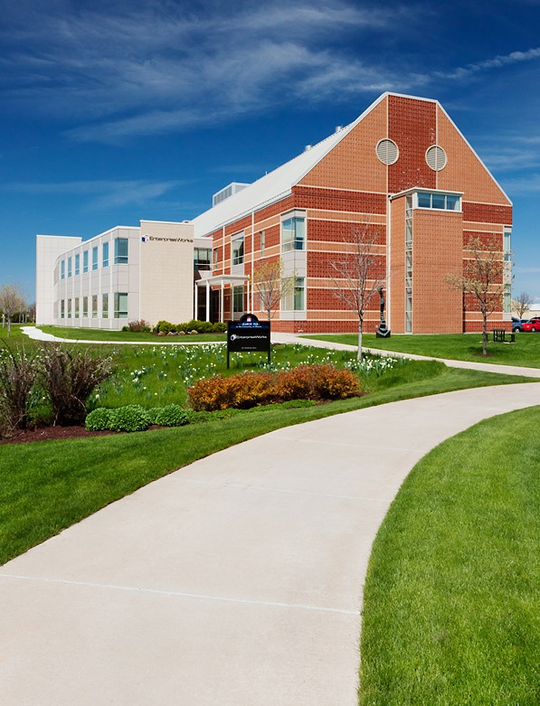
RESEARCH PARK: REMARKABLE GROWTH IN TWO DECADES
61
Start-ups in the EnterpriseWorks incubator at any given time.
$1.1B
Venture capital/private equity financing raised by companies that incubated at EnterpriseWorks.
$155.8M
SBIR/STTR funding since EnterpriseWorks opened in 2003.
50+
Active start-ups based on university technology, across the U.S.

Slide 14
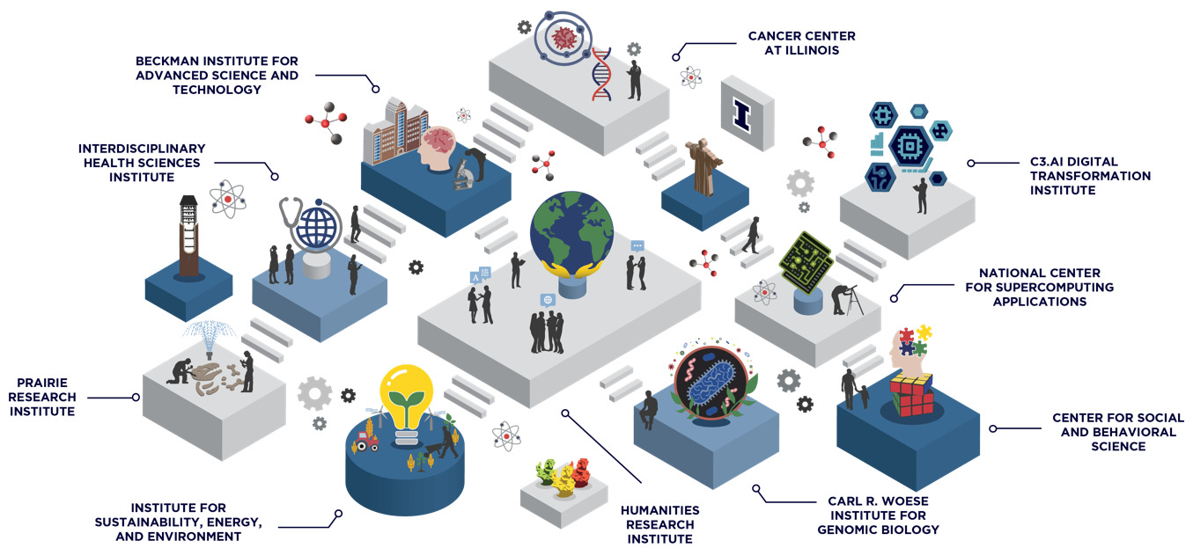
ILLINOIS RESEARCH INSTITUTES
DISCIPLINARY STRENGTHS. CONVERGENT RESEARCH.
Together, the ten Illinois research institutes transcend college, school, and departmental boundaries to elevate ideas, drive discovery, and push the boundaries of our knowledge.

Slide 15
ILLINOIS RESEARCH INSTITUTES
EDUCATION
& TRAINING
RESEARCH INFRASTRUCTURE
HIGH-PROFILE IMPACTS
RESEARCH EXPENDITURES
RECRUITMENT
& RETENTION

Slide 16
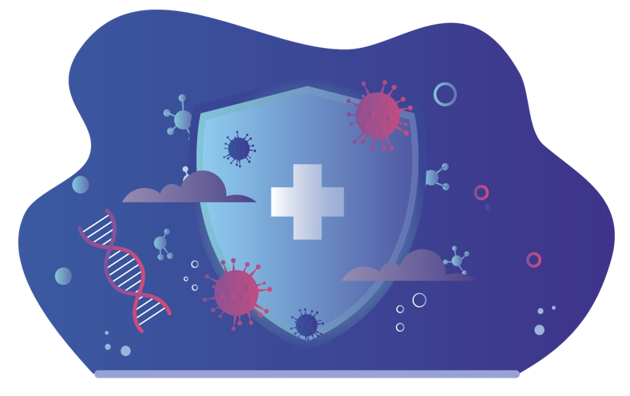
UIUC’S RESPONSE TO COVID-19
Illinois researchers have devised novel approaches to test, treat, analyze, and manage COVID-19.
Founded the Illinois National COVID-19 Registry, a repository of biological samples and data for use by the nation’s researchers.
Developed a saliva-based testing program for use on campus, the state, and across the nation.
Created and analyzed multiple COVID-19 epidemic models for the State of Illinois.
1
2
3

Slide 17
THE POWER OF I
A pre-eminent public RESEARCH INSTITUTION
with a land-grant mission and global impact
THE UNIVERSITY OF ILLINOIS URBANA-CHAMPAIGN

Slide 18
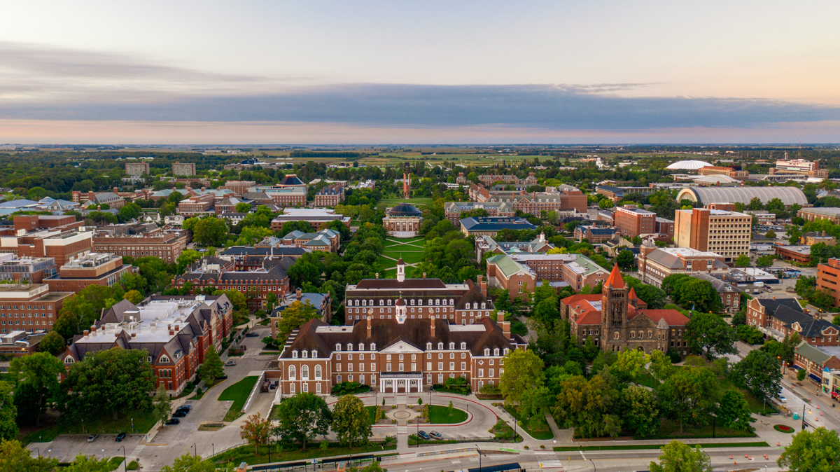
STAY CONNECTED
Subscribe to This Week in Illinois Research.
go.Illinois.edu/twir
Follow @UOFIResearch on Twitter.
research.Illinois.edu

