Slide 1
Creating Conflict Management Plans
Linda Lee Drozt
Regulatory Research Coordinator, Office of the Vice Chancellor for Research
Melanie Loots
Executive Associate Vice chancellor for Research, Office of the Vice Chancellor for Research

Slide 2
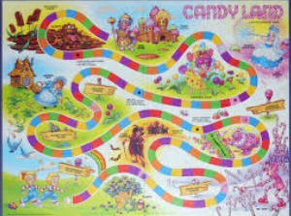
Can Candyland help with conflict management?
Navigate the Peppermint Forest
Climb the Gumdrop Mountains
Identify the Molasses Swamp

Slide 3
OBJECTIVES
Understand various roles in conflict management
Recognition of situations where a Conflict Management Plan is needed
Learn about the components of a Conflict Management Plan
Learn about mechanisms that can be used to manage apparent conflicts of interest and included in the Conflict Management Plan

Slide 4
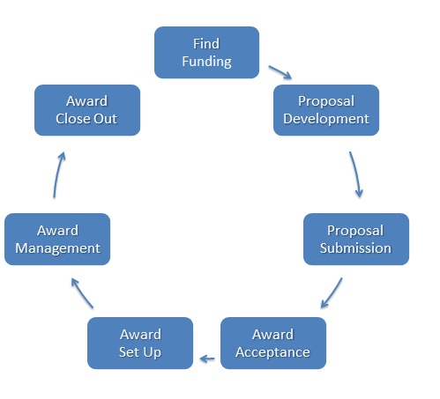
Where we are in the lifecycle
Disclosure
processes may
identify
Conflicts of
Interest at
any point in the
LIFECYCLE
Ideally, conflicts are identified prior to
Proposal Submission through RNUA or
agency-specific disclosure processes
Conflicts must be managed prior to
Award Acceptance

Slide 5
Various roles in conflict management
Everyone – Be familiar with the Policy
Faculty and Staff – annual disclosure of outside activities, other required disclosures, update when new interests or activities arise
Unit Executive Officer – review and approve disclosures of outside activities, approve plans for conflict management, ongoing oversight
Departmental business and HR staff – support the UEO review process and development of Conflict Management Plans
Dean – second level of review and approval for disclosures, Conflict Management Plan
Director of Graduate Studies – oversee issues with student involvement
Pre-Award Grants and Contracts – ensure disclosure and COI management is in place prior to award

Slide 6
Definition of Conflict of interest
A conflict of interest exists when an academic staff member is in a position to advance his/her own interest or that of others to the University’s detriment
A conflict of commitment arises when the external activities of an academic staff member are so demanding of time or attention that they interfere with the individual’s responsibilities to the University

Slide 7
CONFLICT OF INTEREST MANAGEMENT
The Unit Executive Officer works with the academic staff member to identify and evaluate potential conflicts and to manage or eliminate them.
Identification of conflicts is facilitated by prompt disclosure, by the annual Report of Non-University Activities, by other disclosure processes mandated by federal regulations, and by helpful colleagues who contact the UEO or the COI Office.

Slide 8
potential conflicts of interest NEEDING MANAGEMENT
Company in which University employee has an interest
Licenses University IP (requires COI plan)
Sponsors research, technical testing or other activity at the University (requires COI plan)
University contracts with a business in which a University employee has significant interest
A Professor’s start-up company employs University students or other University employees
Teaching or other employment at another university (generally not permitted)
University resources are used to support research for a company in which the employee has a financial interest
Spending more than 1 day per week on outside activities (relative to appointment)
Immediate family members are paid on a sponsored project
Students involved in faculty consulting activity

Slide 9
When is a coi management plan not needed?
When the level of outside activity is low and none of the above conditions apply, conflicts of interest and commitment may be managed by disclosure and approval of the disclosure, or by creating an MOU between the employee and the UEO.
Employee has private consulting business
Employee farms and has farm income
Employee has significant financial interest in a company that contracts with the University, but with no connection to his/her University responsibilities (e.g., Kraft stock ownership, IBM stock ownership)

Slide 10
Is the potential conflict of interest manageable?
Is the activity in the best interest of the University?
Is the activity compatible with the individual’s University responsibilities?
Is it possible to prevent detriment to the University’s interest?
Can the activity be kept separate from the individual’s University responsibilities? (can you keep it on the Ice Cream Floats?)
Can the conflict be managed with mechanisms that are relatively straightforward to implement?
Any concern with the employee’s current performance?
Public perception or any other concerns?

Slide 11
It’s OK to SAY NO
Remember DARE?
The UEO has the responsibility to deny permission for an outside activity if s/he believes that it is not manageable.
If the UEO feels the activity is not manageable, there is no need to develop a Conflict Management Plan.
Thus, the UEO needs to be consulted early in the process.
The employee may appeal to the next level (see COI Policy).

Slide 12
CONFLICT MANAGEMENT STEPS – the Peppermint Forrest
Full disclosure in writing by the employee (using RNUA form is recommended)
Approval of the activity by the UEO
Conversation among the UEO, COI office staff, unit administrator(s), the employee(s)
Conversation with the Directors of Undergraduate and/or Graduate Studies if students are potentially involved
Possible consultation with
Office of Sponsored Programs
Office of Technology Management
University Legal Counsel
CEO or other management from the outside entity can be helpful
Other units or departments as needed – Dean, Provost, Research Institute

Slide 13
Steps in creating a conflict management plan, Cont.
Employee provides background
Status of the company or other activity
Status of any licensing arrangements with the University
Business aims of the company or goals of other activity
Expected time commitment
Anticipated involvement of students or other University employees
Anticipated desire to use University resources, possible technical testing or facilities use agreement
Anticipated sponsored activity between the University and the company
Relationship between the employee’s university responsibilities and the outside activity
Any current or potential future sponsored funding from the Public Health Service
Any concerns the employee may have

Slide 14
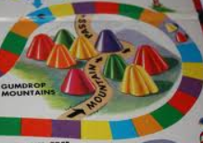
Climb the gumdrop mountains - Draft a plan
Business staff in the unit draft the Conflict Management Plan, with the assistance of the COI Office.
A template is available
A questionnaire to collect information on the activity is in preparation

Slide 15
Sections of a typical conflict management plan
Background
Management of Employee Conflict of Commitment
Managing Conflicts of Interest Concerning Involvement of Other University Personnel
Relationship between the Outside Activity and the Employee’s University Responsibilities
Management of Conflicts of Interest Concerning Use of University Resources or Intellectual Property
Management of Conflicts of Interest Relating to Human Subjects Research (when applicable)
Review cycle and Reporting
Attachments
Signatures of Approval (Employee, UEO(s), Dean(s), Institute Director (if applicable), members of the Management Oversight Committee, OVCR)

Slide 16
Management mechanisms that may be included in plan
Disclosure
Monitoring
Oversight committees or review panels – consider frequency of meetings
Disclosure in publications and presentation
Pre-review of publications and presentations
Recusal from decisions
Divesting financial interests
Leave of absence or reduction in appointment
Or you can be creative….

Slide 17
More management mechanisms
Special attention to students and employees involved in the outside activity – communication with OVCR to ensure that they have a contact outside the unit in case of problems or concerns
If students are involved in the outside activity and also enrolled in a course taught by the employee, special oversight of grading should be implemented
Other university staff should not be involved in scheduling meetings, making copies, processing orders, answering phone calls, etc. regarding the outside activity
If family members are involved in sponsored projects, ensure that this is in compliance with the Policy on Employment of Relatives and that appropriate oversight is in place
Travel associated with the outside activity should be clearly separated from travel associated with University responsibilities

Slide 18
Final Steps – Watch out for the Molasses Swamp*
Management Oversight Committee and UEO meet with the employee and review the plan
*Obtain signatures of approval – electronic signatures are OK
OVCR signs off last
OVCR distributes copies of the plan to
All signatories
OSP
OTM
Purchasing
Others as needed
Revise the Plan when significant changes in activity occur

Slide 19
Complex relationships
Outside activities are often beneficial, and we work hard on conflict management, but remember – if the Conflict Management Plan is too complex, it may not be feasible – the plan has to be followed, not just written down.

Slide 20
Multiple employees from one unit involved in activity
UEO determines whether to have a single Conflict Management Plan for the activity OR a plan for each individual
Separate plans for faculty and academic professionals may be advisable
Company business should be conducted outside the workplace
Plan may specify that discussions be scheduled offsite
Other university staff should not be involved in scheduling meetings, making copies, answering phone calls, etc.

Slide 21
Multiple employees from different units
Consult the UEOs to determine
The best home unit for the Conflict Management Plan
One Conflict Management Plan for the activity, or one plan per employee?
A common committee for all participants, or separate committees?
Separate plans for faculty and academic professionals may be advisable
Expectations are generally different
Management mechanisms may differ
Keep all UEOs and institute directors informed

Slide 22
When the employee heads an institute or laboratory?
If the employee is the head of a research institute reporting to a Dean, Vice Chancellor, or Provost, then the conflict management should be developed in consultation with the Dean, VC, or Provost.
Generally we would expect that the oversight committee would report to the Dean, VC or Provost
The UEO(s) of the home unit(s) of the employee should approve the plan and be consulted as the plan is developed, informed of management oversight discussions, etc.

Slide 23
What if the ueo is conflicted?
The Conflict Management Plan may be
Administered by the College
Assigned by the College to another Unit to administer

Slide 24
What if the dean is conflicted?
Provost will work with the COI Office to develop a conflict management strategy that does not involve the Dean.
For example, a management oversight committee could be composed of a number of other Deans and/or very senior faculty.

Slide 25
Questions?

