Slide 1
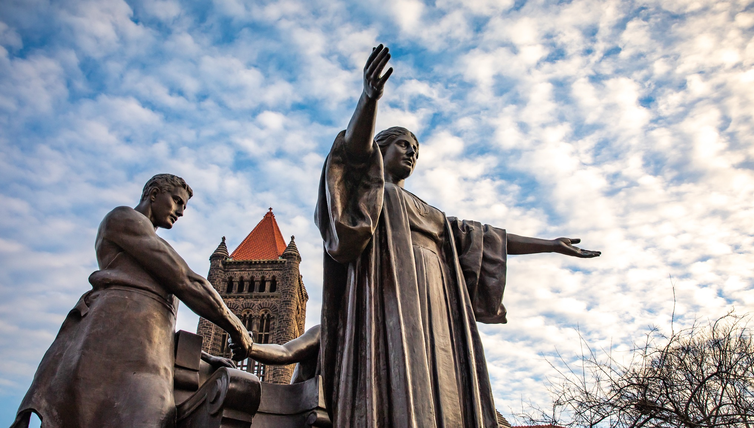
DEPARTMENT OF ENERGY
INTERIM POLICY ON
CONFLICTS OF INTEREST
UNIVERSITY OF ILLINOIS URBANA-CHAMPAIGN
© 2022 University of Illinois Board of Trustees

Slide 2
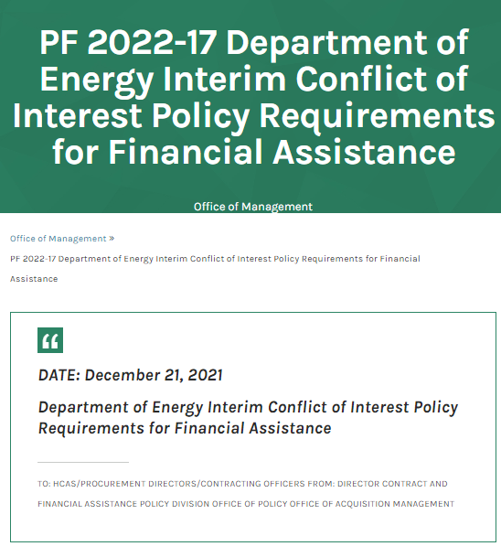
WHAT HAPPENED?
December 21, 2021, the Department of Energy released an interim policy on financial conflicts of interest
https://www.energy.gov/management/pf-2022-17-department-energy-interim-conflict-interest-policy-requirements-financial
Nearly identical to the Public Health Service regulations which have been in place for nearly 10 years
© 2022 University of Illinois Board of Trustees

Slide 3
DOE FCOI INTERIM POLICY
Applies to grants and cooperative agreements from DOE and national labs
Effective December 21, 2021, institutional compliance required within 180 days
Interim policy will be a part of funding announcements and award terms going forward
For existing awards, we anticipate the interim policy terms will be added through amendments
© 2022 University of Illinois Board of Trustees

Slide 4
COMPARING COCI/RNUA TO UI/DOE FCOI POLICY
The University’s Policy on Conflicts of Commitment and Interest focuses on disclosure of income-producing outside activities to identify conflicts of commitment or interest for all academic employees in order to protect public resources.
Form: RNUA
The DOE policies focus on investigator disclosure of significant financial interests and externally sponsored travel to identify financial conflicts of interest that could bias DOE-funded research.
Form: Sponsor-Specific Questionnaire
© 2022 University of Illinois Board of Trustees

Slide 5
WHO IS COVERED BY THE INTERIM POLICY?
Investigators
A very broad definition
Any person, regardless of title or position, who is responsible for or participates in the purpose, design, conduct, or reporting of research funded by DOE
© 2022 University of Illinois Board of Trustees

Slide 6
WHAT DOES THIS MEAN FOR ME AND MY TEAM?
Additional compliance steps at proposal submission and throughout the life of an award
START myDisclosures
myFCOI Checklist
© 2022 University of Illinois Board of Trustees

Slide 7
DOE FCOI INTERIM POLICY
Investigator Responsibilities
Complete Training on Financial Conflicts of Interest
Disclose Significant Financial Interests and Sponsored Travel
Institutional Responsibilities
Identify and manage Financial Conflicts of Interest
Provide information about FCOI to DOE and, upon request, the public
© 2022 University of Illinois Board of Trustees

Slide 8
TRAINING REQUIREMENT
What?
Each DOE investigator must complete training that covers:
the University’s policy on financial conflicts of interest in research,
DOE’s Interim COI Policy, and
the Investigator's responsibilities regarding disclosure of significant financial interests
When?
Before engaging in DOE-funded projects and at least every four years
How?
Attending a live training session or
As part of the significant financial interest disclosure
© 2022 University of Illinois Board of Trustees

Slide 9
WHAT DO I DISCLOSE?
Disclose all Significant Financial Interests* that appear to be related to your institutional responsibilities.
Research or research consultation
Teaching
Professional practice
Institutional committee memberships
Service on panels such as Institutional Review Boards or Data and Safety Monitoring Boards
Institutional Responsibilities include:
*Your SFIs and the SFIs of your spouse and dependent children that appear to be related to your institutional responsibilities.
© 2022 University of Illinois Board of Trustees

Slide 10
WHAT IS A SIGNIFICANT FINANCIAL INTEREST?
Any interest ≥ $5000 in a publicly traded company
This includes equity and other remuneration for consulting, honoraria, etc.
Aggregate value over preceding 12 months
© 2022 University of Illinois Board of Trustees

Slide 11
WHAT IS A SIGNIFICANT FINANCIAL INTEREST?
Any remuneration from or interest in a non-publicly traded entity (including non-profits) >$0
Any interest in start-up companies
Payments for consulting, honoraria, and journal editing
© 2022 University of Illinois Board of Trustees

Slide 12
WHAT ISN’T A SIGNIFICANT FINANCIAL INTEREST?
SFI excludes:
income from investment vehicles that the investigator does not control (e.g., mutual funds)
income from seminars, lectures, teaching, advisory board or review panel for:
U.S. federal, state, or local government
U.S. institutions of higher education
research institutes affiliated with U.S. institution of higher education
© 2022 University of Illinois Board of Trustees

Slide 13
WHEN DO I DISCLOSE?
At proposal submission
Before participating in the project
and
At least annually
Within 30 days of acquiring a new SFI
© 2022 University of Illinois Board of Trustees

Slide 14
CASE STUDY #1
Issue
A faculty member with a DOE grant consults for a start-up company commercializing a technology developed in her lab and is paid with stock options.
Solution
The financial interest must be reported
The company is not publicly traded; therefore, a financial interest of any value must be disclosed.
The faculty member must disclose this financial interest within 30 days of starting consulting.
© 2022 University of Illinois Board of Trustees

Slide 15
CASE STUDY #2
Issue
A research scientist who works on a DOE grant invests $6,000 in a mutual fund.
Solution
The research scientist is not required to disclose this financial interest.
Mutual funds are exempt from disclosure if independently managed.
© 2022 University of Illinois Board of Trustees

Slide 16
SPONSORED TRAVEL DISCLOSURE
Disclose ANY externally sponsored or reimbursed travel from a single source with an aggregate value ≥ $5000 in the preceding 12 months, unless exempt
Exemptions are the same as with other SFI: UI, other U.S. academic institutions, federal, state or local government agencies
All travel covered by corporations, non-profit organizations, international universities or organizations must be disclosed
Include family travel expenses, including the travel of spouse and dependent children.
© 2022 University of Illinois Board of Trustees

Slide 17
SPONSORED TRAVEL DISCLOSURE
Must disclose prior to or within 30 days of travelling
Information Collected:
Purpose of Travel
External Sponsoring Organization
Travel Dates
Destination(s)
Estimated Value of Travel
Family Travel Expenses Paid
© 2022 University of Illinois Board of Trustees

Slide 18
TRAVEL DISCLOSURE CASE STUDY #1
Issue
Ohio State Chemistry Department invites an Illinois research scientist working on a DOE-funded grant to give a seminar in Columbus. OSU pays the costs of travel.
Solution
Payment is exempt from disclosure.
The travel sponsor is a U.S. academic institution.
© 2022 University of Illinois Board of Trustees

Slide 19
FINANCIAL DISCLOSURE: MUST DISCLOSE WITHIN 30 DAYS
≥
>
≥
$5,000
For payments and/or equity interests in publicly traded companies, aggregated over the preceding 12 months.
$0
For payments and equity interest in non-publicly traded companies (e.g., start-up companies).
$5,000
For reimbursed or sponsored travel from a single source in the preceding 12 months.
© 2022 University of Illinois Board of Trustees

Slide 20
ENHANCED CERTIFICATION AT DISCLOSURE
I understand that this Disclosure is required to obtain funding from the U.S. Government. I, [Full Name and Title], certify to the best of my knowledge and belief that the information contained in this Disclosure Statement is true, complete, and accurate.
I understand that any false, fictitious, or fraudulent information, misrepresentations, half-truths, or omissions of any material fact, may subject me to criminal, civil or administrative penalties for fraud, false statements, false claims, or otherwise. (18 U.S.C. §§ 1001 and 287, and 31 U.S.C. 3729-3730 and 3801-3812).
I further understand and agree that (1) the statements and representations made herein are material to U.S. Government’s funding decision, and (2) I have a responsibility to update the disclosures during the period of performance of the award should circumstances change which impact the responses provided above.
© 2022 University of Illinois Board of Trustees

Slide 21
WHEN AN SFI BECOMES AN FCOI
A Significant Financial Interest (SFI) is related to DOE-funded research when the university, through its designated official(s), reasonably determines that the SFI could be affected by the outcomes of the DOE-funded research.
A Financial Conflict of Interest (FCOI) exists when the university, through its designated official(s), reasonably determines that an SFI could directly and significantly affect the purpose, design, conduct or reporting of DOE-funded research.
© 2022 University of Illinois Board of Trustees

Slide 22
FCOI MANAGEMENT
If an FCOI exists, a management plan must be implemented and an FCOI report submitted to DOE within 60 days.
© 2022 University of Illinois Board of Trustees

Slide 23
FCOI MANAGEMENT PLANS
FCOI management plans are implemented and reported on a project basis.
START myDisclosures has the capability to develop, route, and archive FCOI management plans
Public disclosure in presentations and publications
Appointment of independent monitor
Modification of project plan
Change of personnel or personnel responsibilities
Reduction or elimination of SFI
Management mechanisms include:
© 2022 University of Illinois Board of Trustees

Slide 24
PUBLIC ACCESS TO FCOI INFORMATION
Institutions must either post information concerning identified FCOIs held by senior or key personnel on a public website or provide a written response to any requestor within five business days of a request.
Illinois has a procedure to respond to written requests.
© 2022 University of Illinois Board of Trustees

Slide 25
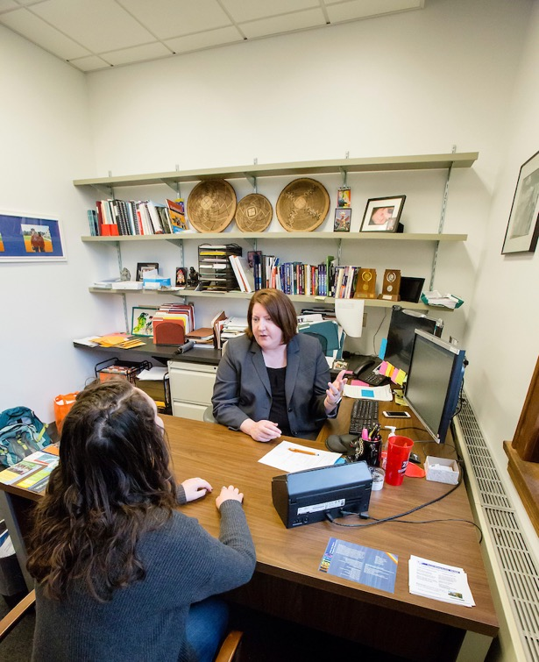
PUBLIC ACCESS TO FCOI INFORMATION
Senior or key personnel are the project director or principal investigator and any other person identified as senior or key personnel by the university in the grant application, progress report, or any other report submitted to the PHS by the university.
Information that would be shared:
Investigator’s name
Investigator’s title and role with respect to the research project
The name of the entity in which the significant financial interest is held
The nature of the significant financial interest
The approximate dollar value (ranges), or a statement that the value cannot be readily determined through reference to public process or other reasonable measures of fair market value
© 2022 University of Illinois Board of Trustees

Slide 26
SUBAWARDS
If the proposal has a subrecipient, the Authorized Administrative Approval provided at the proposal submission stage must include a statement indicating the subrecipient certifies that at the time of award, it will either:
Have a conflict of interest policy that complies with the DOE Interim Policy, or
Agree to adopt and abide by the UIUC’s conflict- of-interest policy.
© 2022 University of Illinois Board of Trustees

Slide 27
SMALL BUSINESS GRANTS
The DOE Interim Policy does not apply to Small Business
Innovative Research (SBIR) and Small Business Technology Transfer (STTR) Programs Phase 1 applications and awards.
© 2022 University of Illinois Board of Trustees

Slide 28
TRAINING AND DISCLOSURE CERTIFICATION
PROPOSAL AND AWARD STAGES
At proposal stage, PI will confirm that all ‘investigators’ are compliant
At award stage, PIs will receive a notice to complete an FCOI checklist
myFCOI checklist is used to list all ‘investigators’ on a project and documents their compliance each year
No anticipation accounts will be granted or award fund created until the project-specific FCOI checklist is submitted and approved.
© 2022 University of Illinois Board of Trustees

Slide 29
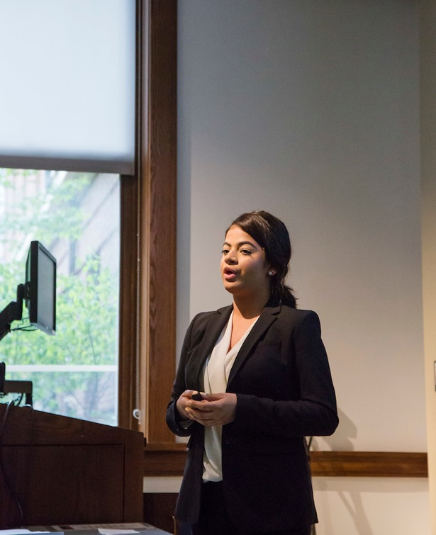
WHO CAN USE MYFCOI CHECKLIST?
Anyone with the Review ID or Institutional Proposal Number:
PI, lab managers, business managers, grants managers
© 2022 University of Illinois Board of Trustees

Slide 30
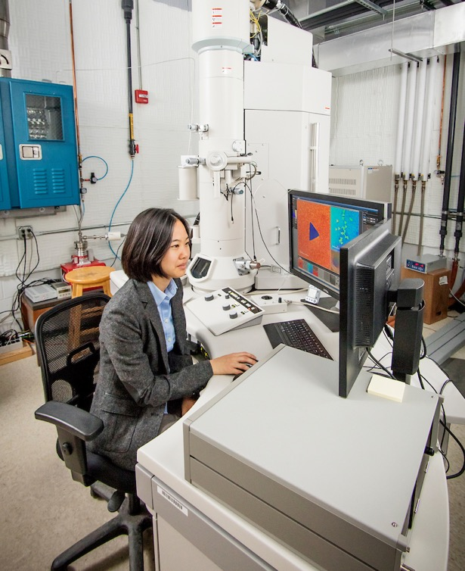
WHAT CAN I DO WITH MYFCOI CHECKLIST
Create a checklist
See if an investigator is compliant
Remind investigators to complete training and/or disclosure
Monitor progress
Submit a checklist
View previously submitted and approved checklists
© 2022 University of Illinois Board of Trustees

Slide 31
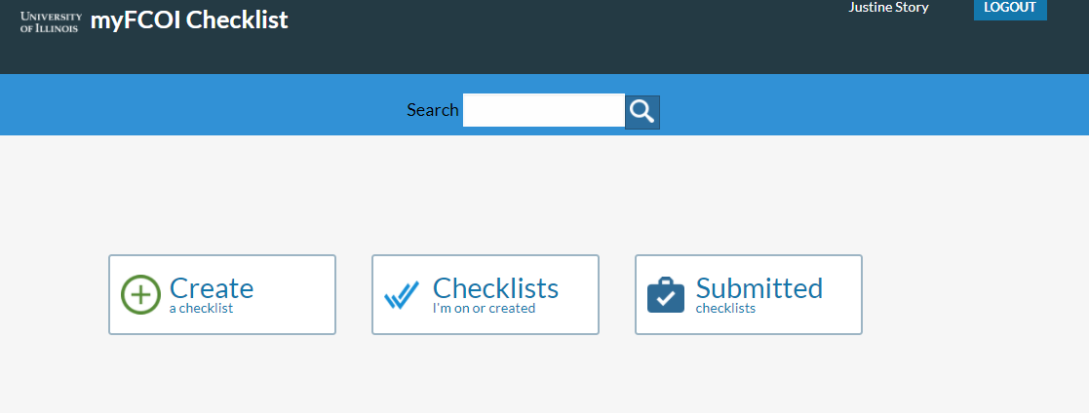
MYFCOI CHECKLIST DASHBOARD
https://myfcoichecklist.uillinois.edu
© 2022 University of Illinois Board of Trustees

Slide 32
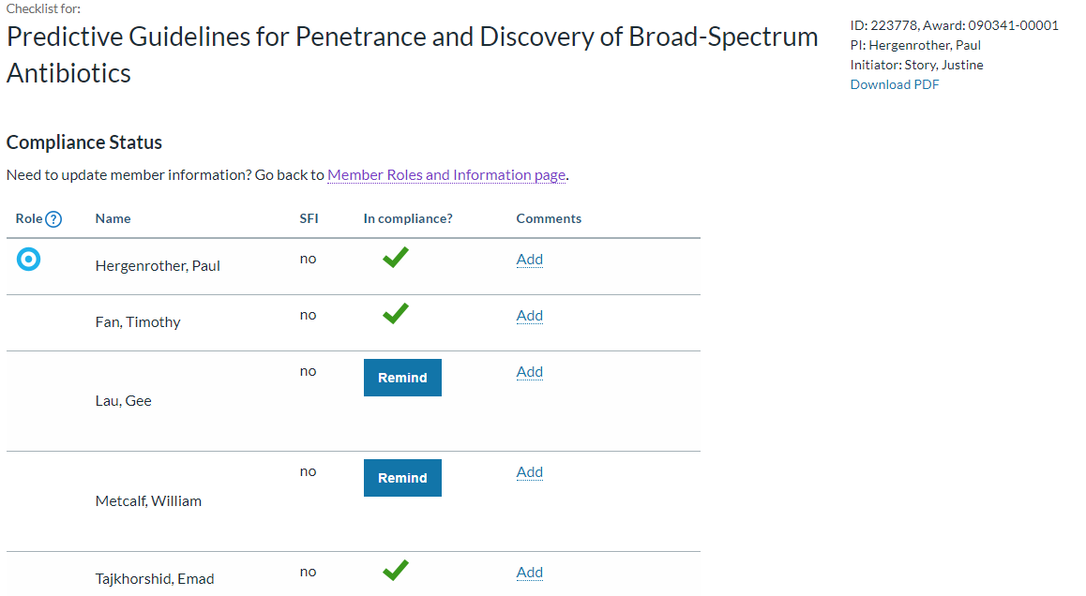
MYFCOI CHECKLIST: COMPLIANCE STATUS
© 2022 University of Illinois Board of Trustees

Slide 33
MYFCOI CHECKLIST: SUBMITTED CHECKLIST STATUS - APPROVED
Once the checklist is approved, the Submitter and PI will receive an email from myFCOI checklist with a notice that the checklist was approved.
© 2022 University of Illinois Board of Trustees

Slide 34
REVIEW
START myDisclosures
myDisclosures.uillinois.edu
FCOI training
Submit Sponsor-Specific Questionnaire: SFIs and Travel
myFCOI Checklist
myfcoichecklist.uillinois.edu
Document investigator compliance for each project
© 2022 University of Illinois Board of Trustees

Slide 35
WHAT RESOURCES ARE AVAILABLE FOR ME AND MY TEAM?
Contact: coi@illinois.edu
FCOI at Illinois: go.illinois.edu/FCOI
Job aides linked within systems
Technical Support from AITS
© 2022 University of Illinois Board of Trustees

Slide 36
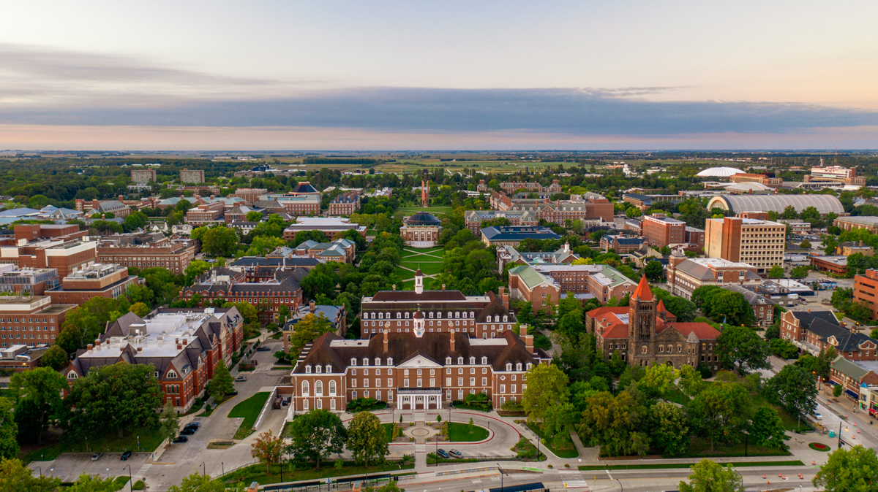
STAY CONNECTED
Subscribe to This Week in Illinois Research.
go.Illinois.edu/twir
Follow @UOFIResearch on Twitter.
research.Illinois.edu
© 2022 University of Illinois Board of Trustees

