Slide 1
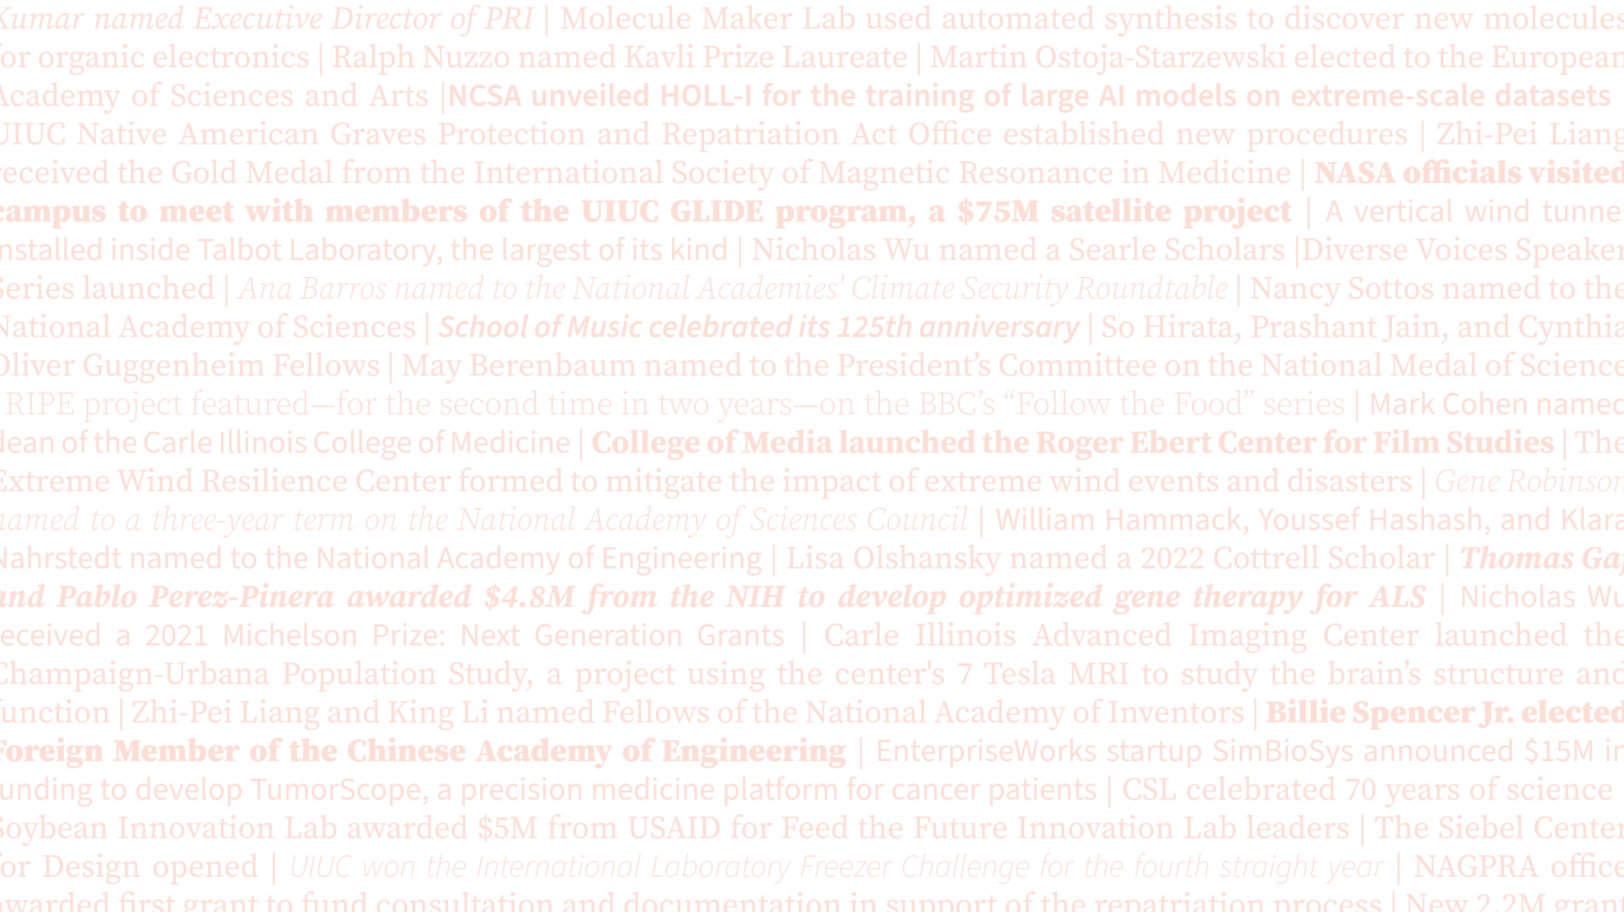
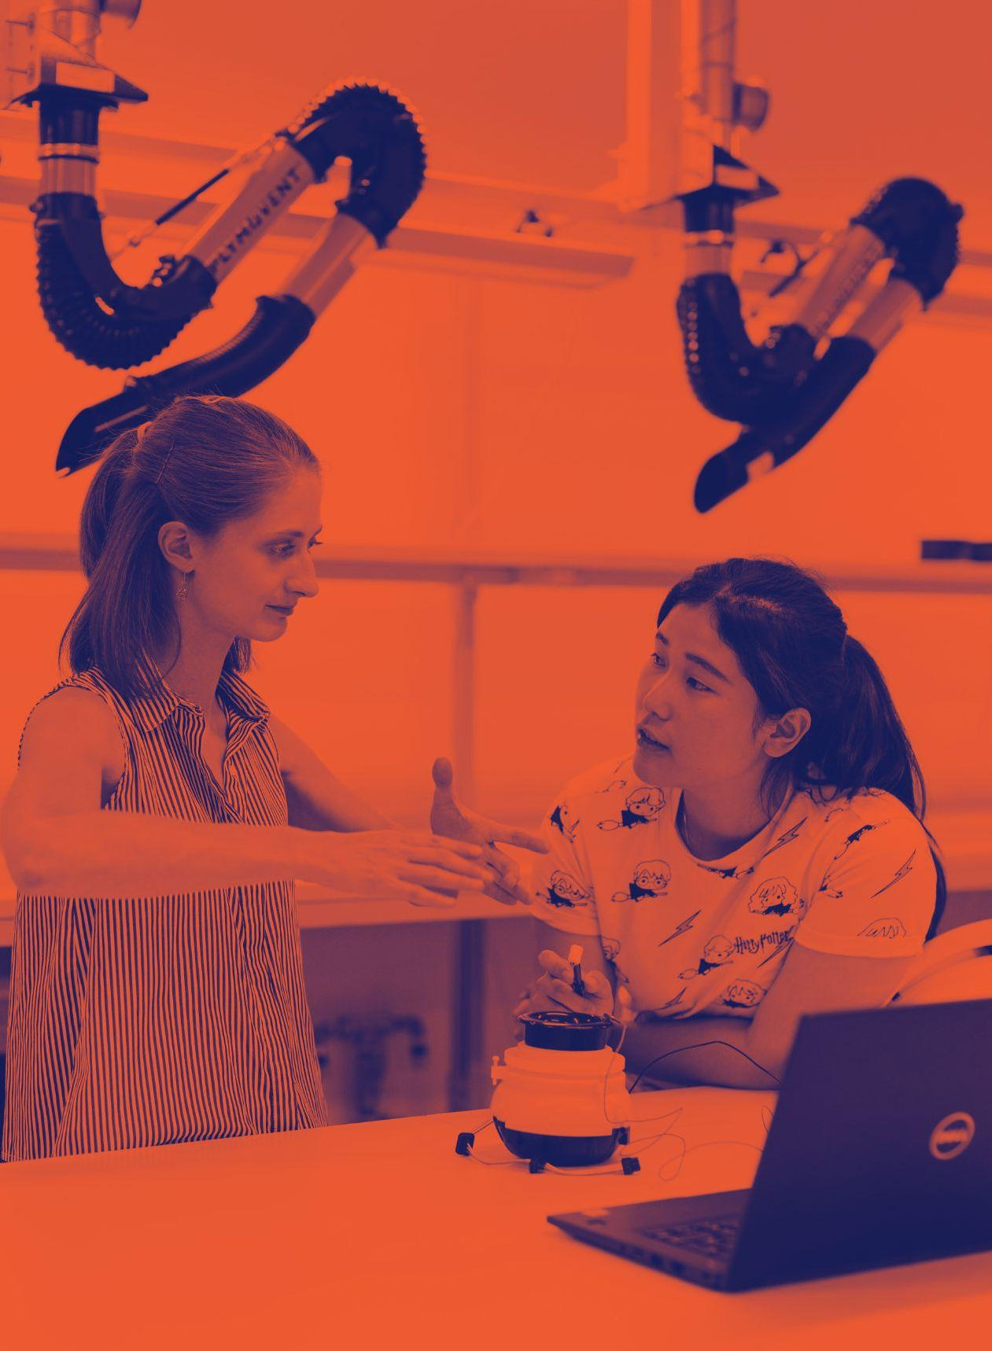
RESEARCH & INNOVATION
Overview

Slide 2
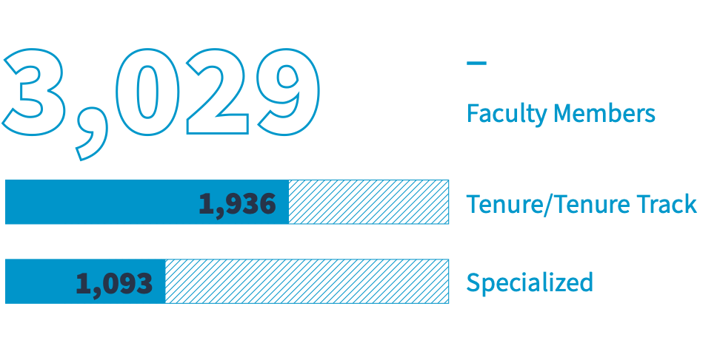
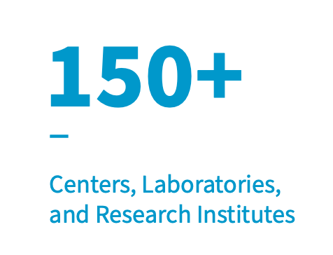
BY THE NUMBERS
UIUC

Slide 3
We’ve
been
changing the world since 1867.
Rich history.
Bright future.
Illinois research combines scholarly expertise with world-class infrastructure, fuses disciplines, sparks collaborations, and nurtures the next generation of scholars.
We’ve been changing the world since 1867.
Find out how at research.illinois.edu or follow us at @UofIResearch.

Slide 4
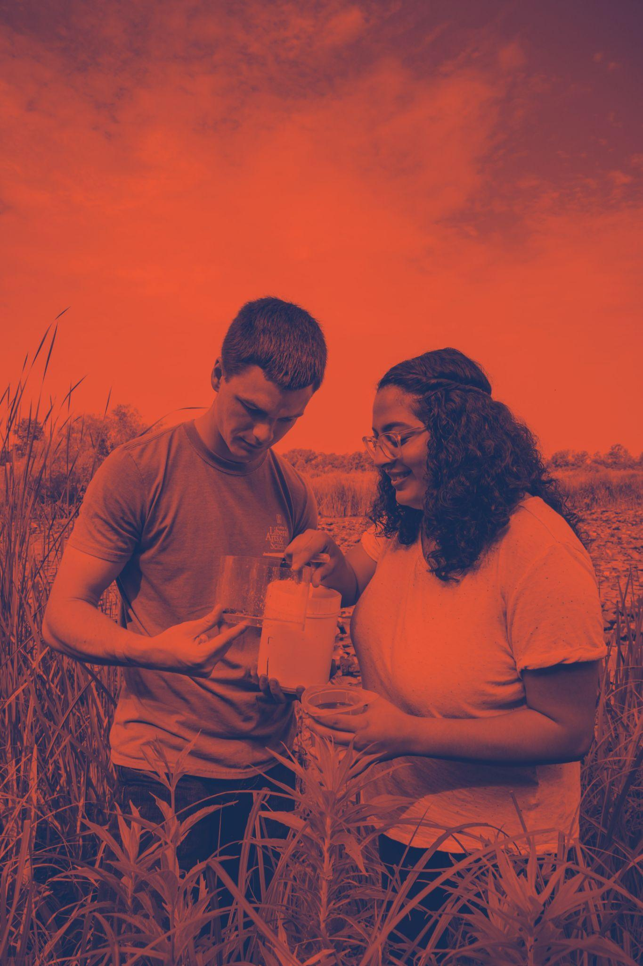
A UNIQUE BREADTH AND INTERDISCIPLINARY FOCUS
The nation’s top doctoral institution for producing Fulbright U.S. Scholars in 2021-22
Regularly among the top 25 in USDA and DOD awards
A 9% increase in DOE research expenditures, placing us third in the nation in DOE support
Routinely among the top 10 in NSF funding
NIH support has increased nearly 40% over the last five years

Slide 5
RESEARCH EXPENDITURES
Federal, state, and private investments in research power discovery and innovation at Illinois.
TOTAL EXPENDITURES
(FY17-FY21)
Research and Development
Sponsored Federal Research and Development
FY21 (a 9% increase)
$731M
$406M
FY20
$689M
$388M
FY19
$674M
$382M
FY18
$653M
$354M
FY17
$642M
$359M

Slide 6
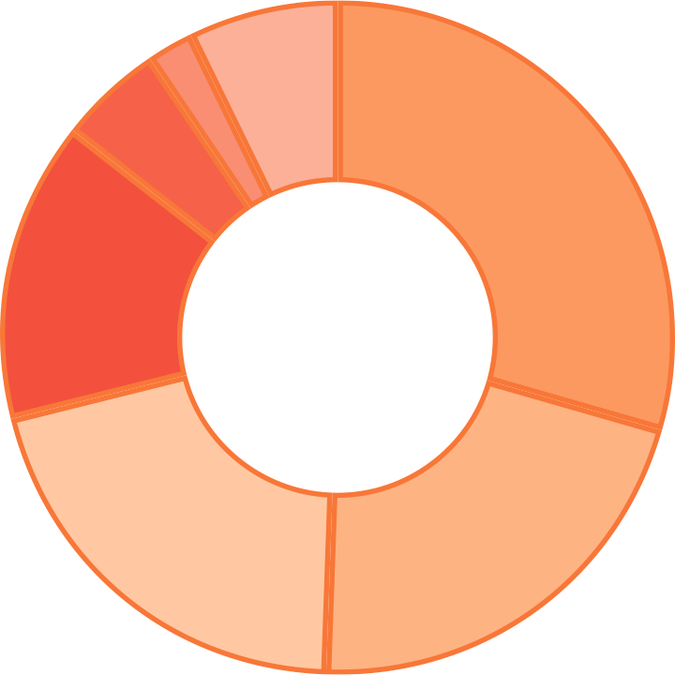
FEDERAL
RESEARCH
EXPENDITURES
BY AGENCY
$28.3M
$10M
$19.8M
$120M
$58.6M
$84.1M
$85.5M
(ranked third
in the nation)
(a 40% increase
in 5 years)

Slide 7
NOTABLE RECENT
RESEARCH AWARDS
$10M (DOE)
For the POETS Research Ecosystem to develop clean energy technologies
$40M (NSF)
For research in neuron-based computing and the expansion of U.S. supercomputing capabilities
$15M (NSF)
To launch the Institute for Geospatial Understanding Through an Integrative Discovery Environment (IGUIDE)
$4M (DOE)
For Front-End Engineering Design (FEED) Project, a study developing commercial-scale carbon capture technology
$10M (USDA)
To optimize the design of “agrivoltaic” systems, a co-location of energy and food production, with $10M in support from the USDA

Slide 8
NOTABLE RESEARCH PROGRAMS
Center for Advanced Bioenergy and Bioproducts Innovation Reducing the U.S.’s dependence on fossil fuels by developing efficient ways to grow bioenergy crops.
AI NSF Institutes UIUC selected to lead two of seven new national AI institutes: AI FARMS and the Molecule Maker Lab.
STRONG Kids 2 A transdisciplinary project exploring how individual biology interacts with the family environment to promote healthy eating habits in young children.
Humanities Without Walls
Linking humanities research efforts at 16 universities throughout the Midwest and beyond.

Slide 9
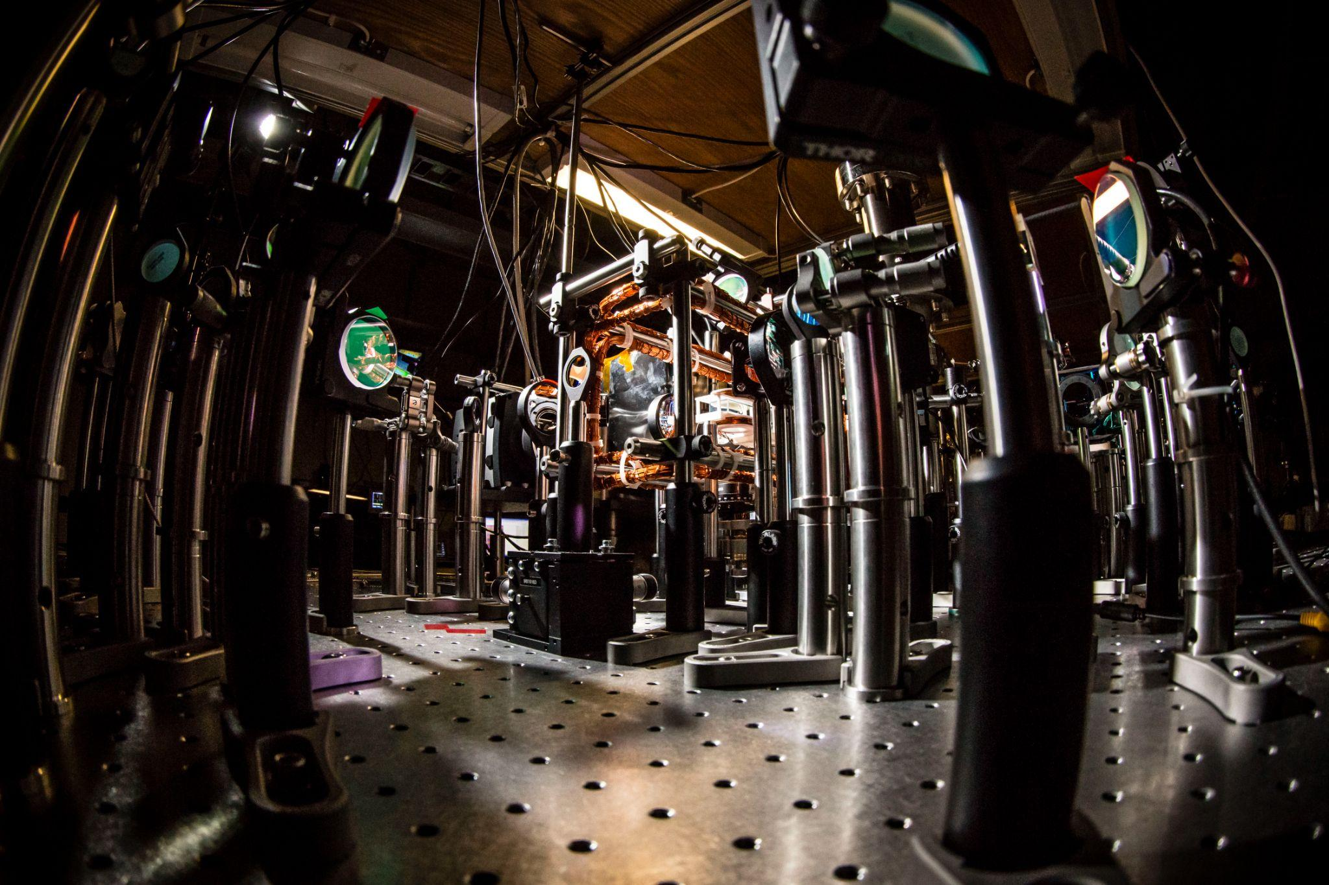
NOTABLE PARTNERSHIPS
C3.AI
$50M C3.ai Digital Transformation Institute launched in partnership with C3.ai, Microsoft, and leading U.S. universities.
Sandia National Laboratories UIUC is a part of Sandia's Academic Alliance Program, a program that partners with universities to solve significant national security challenges.
Taylor Geospatial Institute A new partnership in the Taylor Geospatial Institute, a first-of-its-kind center using geospatial science to develop solutions to global challenges.
IBM
$200M Discovery Accelerator Institute launched in partnership with IBM to develop quantum computing breakthroughs.

Slide 10
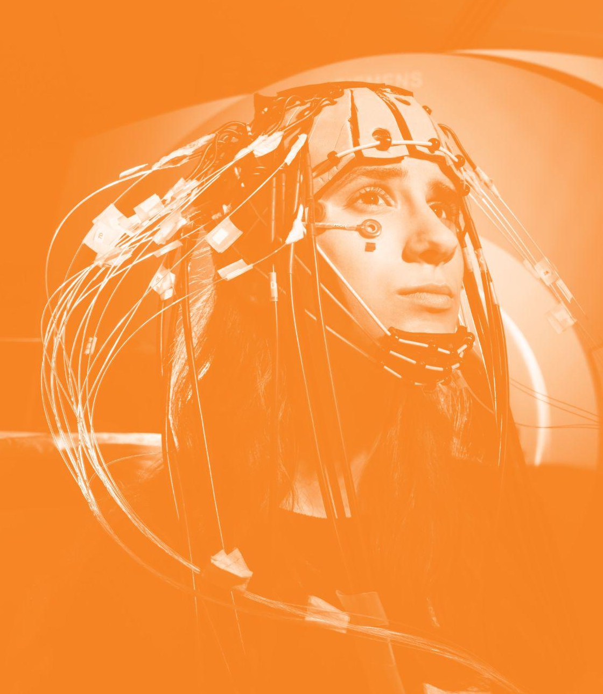
The University of Illinois Urbana-Champaign combines creativity, expertise, and imagination with cutting-edge facilities to conduct world-changing research.
Beckman Biomedical Imaging Facility
Holonyak Micro and Nanotechnology Lab
IGB Core Facilities
Krannert Art Museum
Materials Research Laboratory
NCSA Systems
Roy J. Carver Biotechnology Center
Veterinary Diagnostic Laboratory
NOTABLE INFRASTRUCTURE
go.illinois.edu/infrastructure

Slide 11
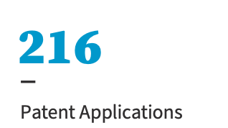
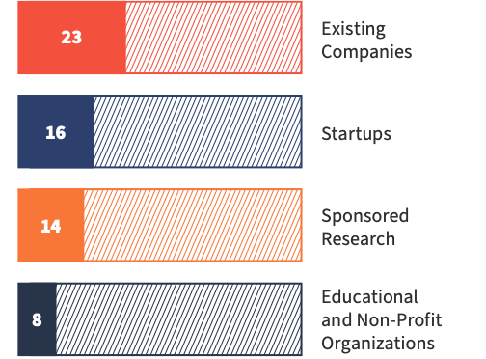
TECHNOLOGY COMMERCIALIZATION
Invention Reports
U.S. Patents
Licenses and Options
61 licences and options transferred 149 technologies.
242
228
215
211
201
otm.illinois.edu

Slide 12
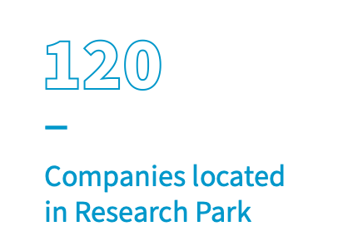
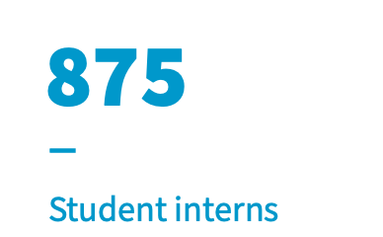
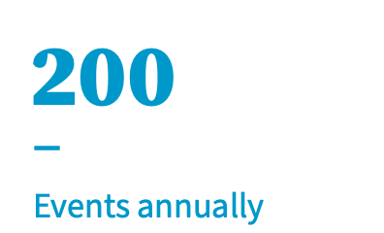
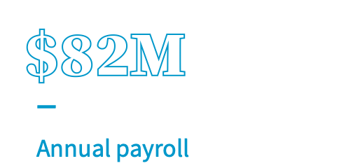
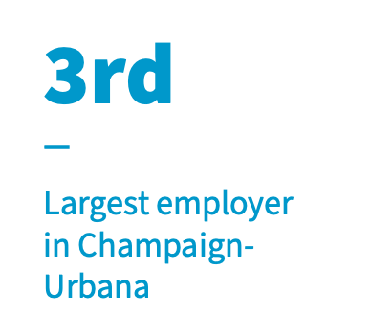
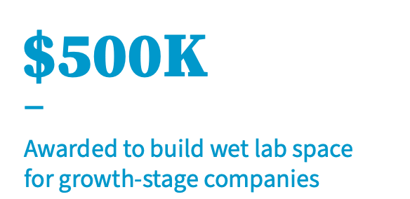
RESEARCH PARK
An environment where technology-based businesses work with faculty and students on collaborative research with access to university labs, equipment, and services.
researchpark.illinois.edu

Slide 13
ENTERPRISEWORKS
Research Park fosters startup companies that commercialize technology through EnterpriseWorks, an incubator for early-stage tech firms that helps launch successful scientific and research-based startup companies.
56 startup tenants
43,000 sq. ft. for start-up incubation
250+ startups have gone through EnterpriseWorks since 2003
$1.2B venture capital raised by startup companies
$147.3M in SBIR/STTR funding awarded to companies since opening

Slide 14
ILLINOIS RESEARCH INSTITUTES
Beckman Institute for Advanced Science and Technology
C3.ai Digital Transformation
Cancer Center at Illinois
Carl R. Woese Institute for Genomic Biology
Center for Social and Behavioral Science
Humanities Research Institute
Institute for Sustainability, Energy, and Environment
Interdisciplinary Health Sciences Institute
National Center for Supercomputing Applications
Prairie Research Institute
CONVERGE
RESEARCH
INNOVATE
CREATE
Together, the ten Illinois research institutes transcend college, school, and departmental boundaries to elevate ideas, drive discovery, and push the boundaries of our knowledge.
go.illinois.edu/illinoisinstitutes

Slide 15
THE
OF ILLINOIS RESEARCH AND INNOVATION
A pre-eminent public research institution with a land-grant mission and global impact.

Slide 16
STAY CONNECTED!
Subscribe to This Week in Illinois Research: go.Illinois.edu/twir
Follow @UofIResearch on Twitter
research.illinois.edu

